Slide 1
Smart Parking in Toronto
Anxin Zhao | Bharadwaj Janarthanan | Seung Eun Yi

Slide 2
Outline
Introduction
Data Collection and Challenges
Analysis Results:
Individual
General Organization
Conclusion
Limitations
Future Considerations

Slide 3
Introduction
30% of the traffic in large cities downtown areas is caused by cars searching for parking.*
It takes around 7.8 minutes to find a free parking spot in average.*
Higher amount of time spent on searching for parking leads to:
traffic congestion
additional consumption of fuel
safety issues & higher stress
*https://www-03.ibm.com/press/us/en/pressrelease/35515.wss

Slide 4
Research Question
Individual level: How could we optimize parking time?
Identify free parking spots
Provide optimal route
General level: Where to place new parking facilities?
Locations where spend most time
Vehicles movement in different neighborhoods

Slide 5
Data Collection
GeoTab: Searching For Parking
City of Toronto: Open Data
Parking tickets, Parking lot facilities,
Green P parking, Vehicle & Pedestrian Volumes
ArcGIS
Restaurants, stores, shopping malls

Slide 6
Data Challenges
Sparsity of Data: We got a big loss of data after merging several datasets.
Merge at 7-character geohash only lead to 21 data points
Solution: Aggregate data at a 6-character geohash level
Nature of Data: The dataset provided by Geotab is created based on an aggregation of data over the past 6 months.

Slide 7
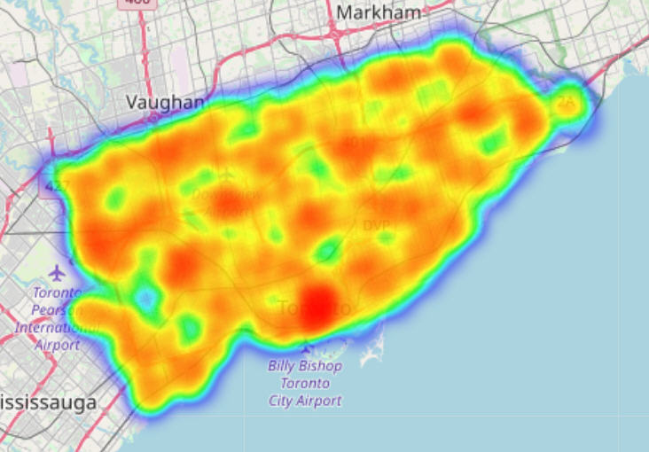
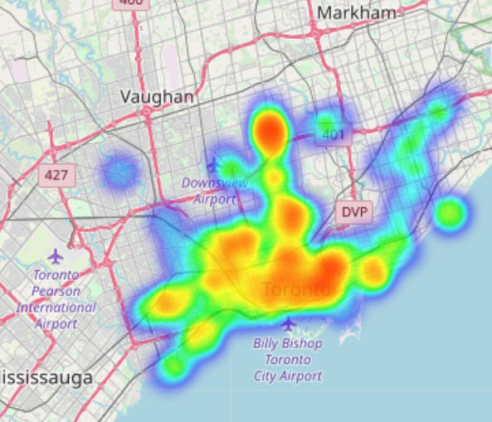
Individual level:
How do we identify free parking spots?
Distribution of cars searching for parking Distribution of parking spots
On the left, heatmap representing the distribution of vehicles looking for parking. On the right, heatmap showing the number of parking spots across Toronto. The redder the area is, the higher the value is.

Slide 8
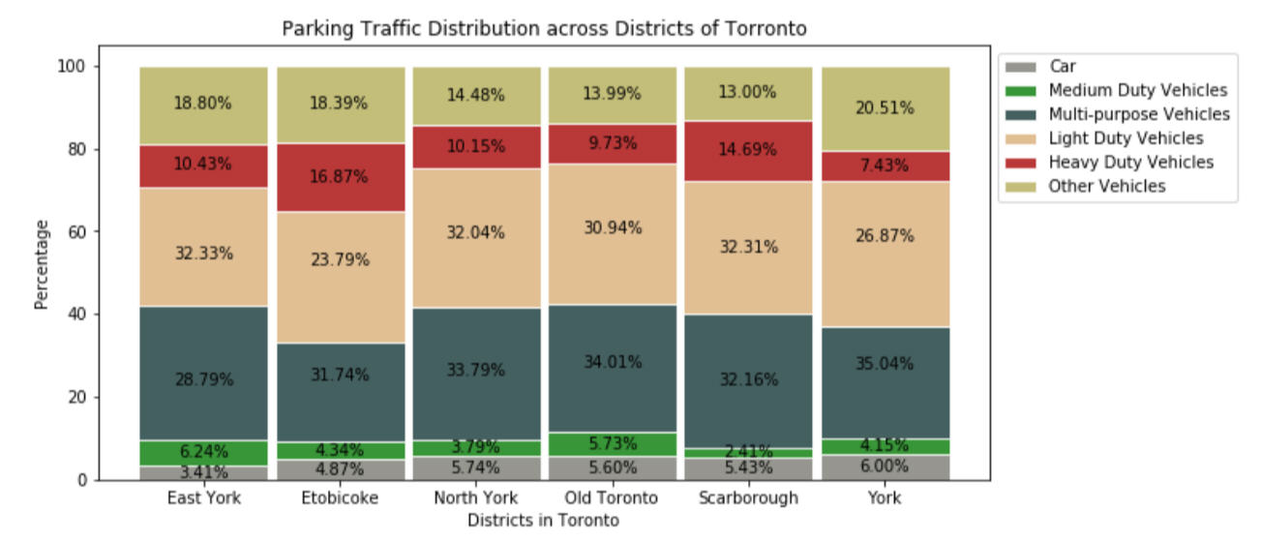
Individual level:
What types of vehicles spend more time searching for parking?

Slide 9
Individual level:
How do we optimize parking time?
Used two different approaches to help reduce parking time for individual vehicles looking for parking.
Rank-based parking geohash suggestion
Features are ranked individually and weighted to produce a final rank.
Used to recommend a geohash to park in given a starting geohash.
Geohash pair behavior analysis
Cluster behaviors of vehicles going from one geohash to park in another.
K-means to create 6 clusters (number of districts).

Slide 10
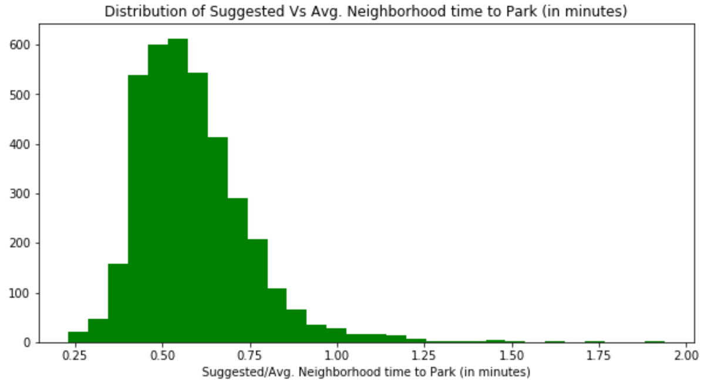
Individual level:
Rank-based parking geohash suggestion

Slide 11
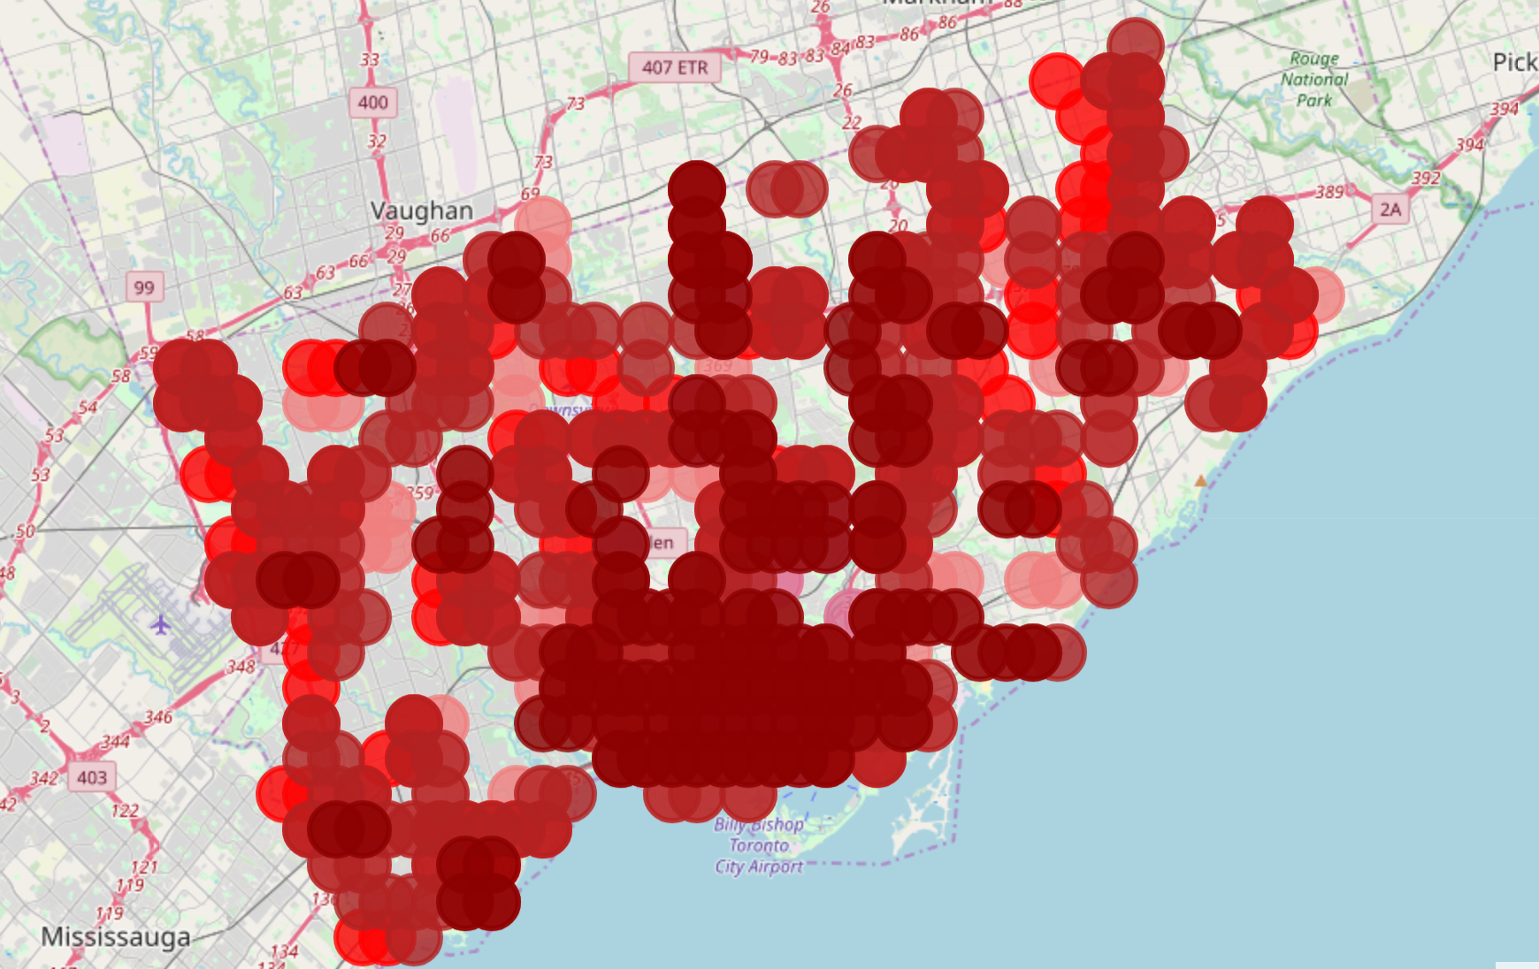
Individual level:
Geohash pair behavior analysis
Heatmap representing the location of different geohash pair behaviors. Each color represents a cluster.

Slide 12
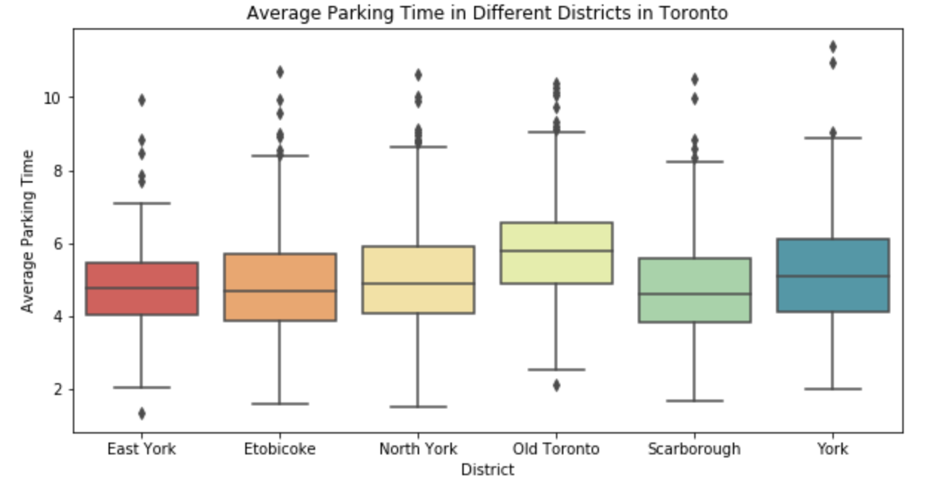
General Organization
Understanding factors influencing organization’s parking time - Does average parking time vary across different districts?

Slide 13
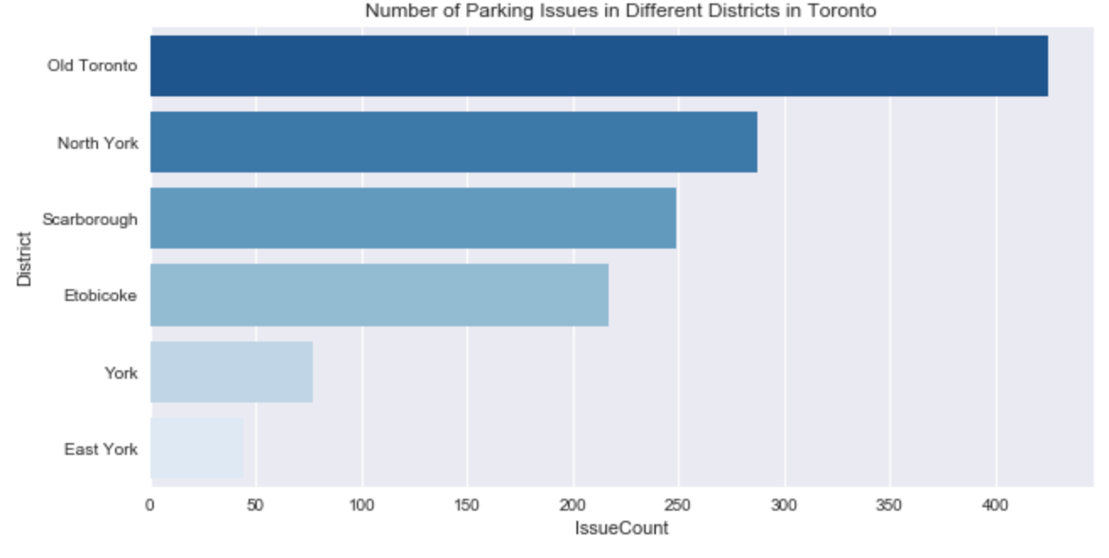
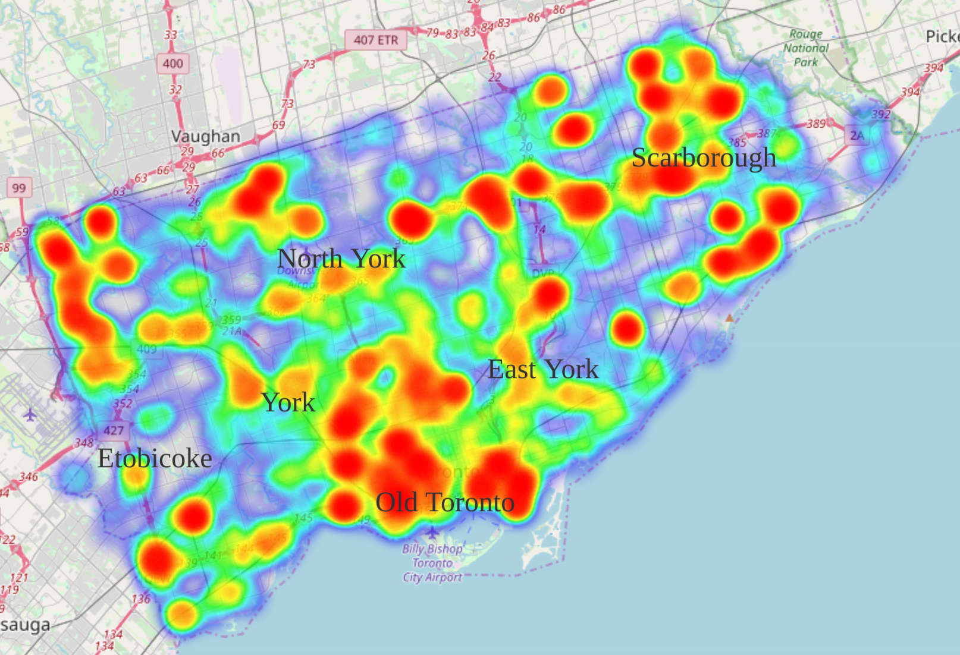
General Organization
Which locations do vehicles spend most time at before finding a parking spot?
Heatmap illustrating differences between percent driving vs. average percentage across Toronto

Slide 14
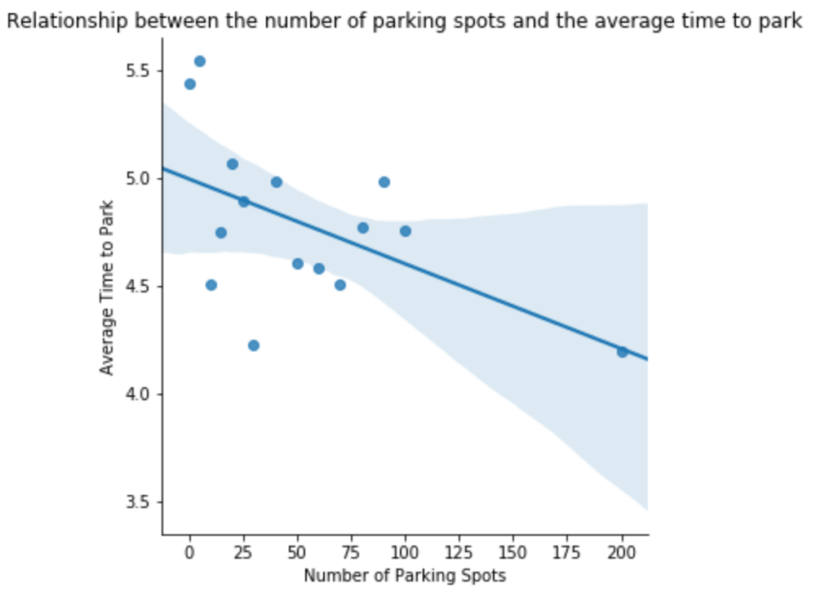
General Organization
Will placing new parking facilities really result in reducing the average searching for parking time?
p-value < 0.05

Slide 15
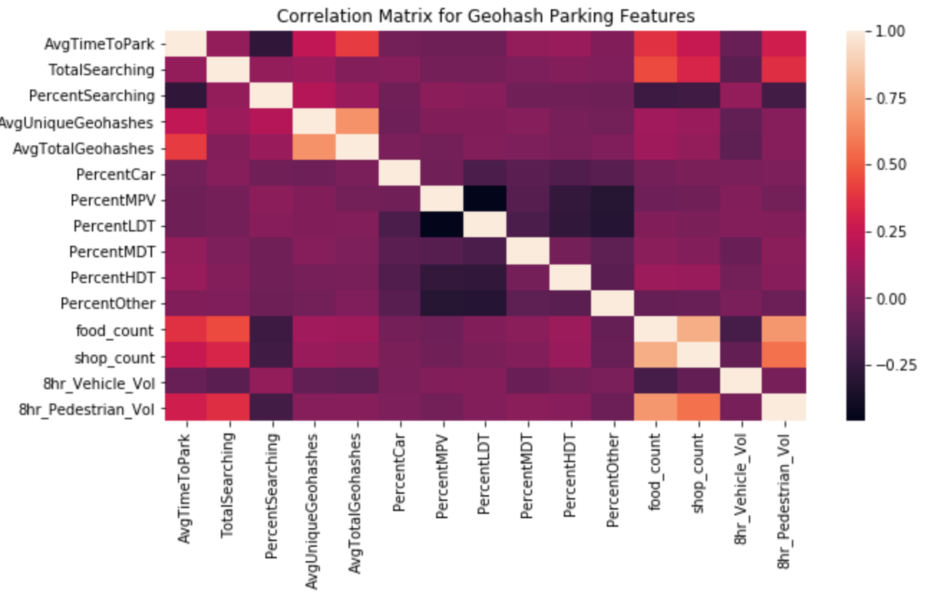
General Organization
How are different factors explored in study correlated with average parking time?

Slide 16
General Organization
Where to place new parking facilities?
Predict average parking time across Geohashes using percentage vehicles searching for parking, total GeoHashes travelled, vehicle type proportions, average hourly parking traffic,restaurant and shop counts along with parking spots available
Surveyed different modelling approaches:
Regression
Random Forest
XGBoost
Multilayer Perceptron model

Slide 17
General Organization
Where to place new parking facilities?
Stratified splitting of Geohash level data into 75% for training and 25% for testing by Districts
Weighted each training Geohash by proportion of vehicles searching for parking in Geohash against total searching for parking in Toronto
Normalized features before feeding into model
To pick best performing model in terms of prediction, we compare accuracy and R-Squares across different models in both train and test data sets

Slide 18
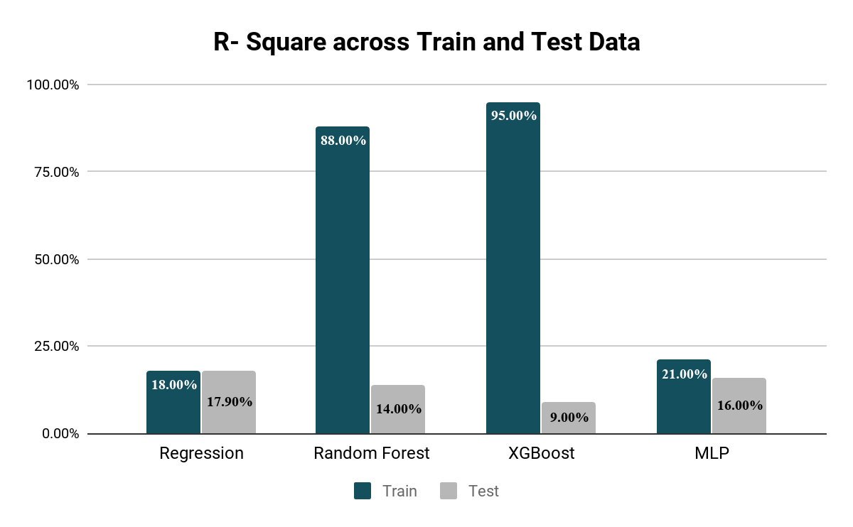
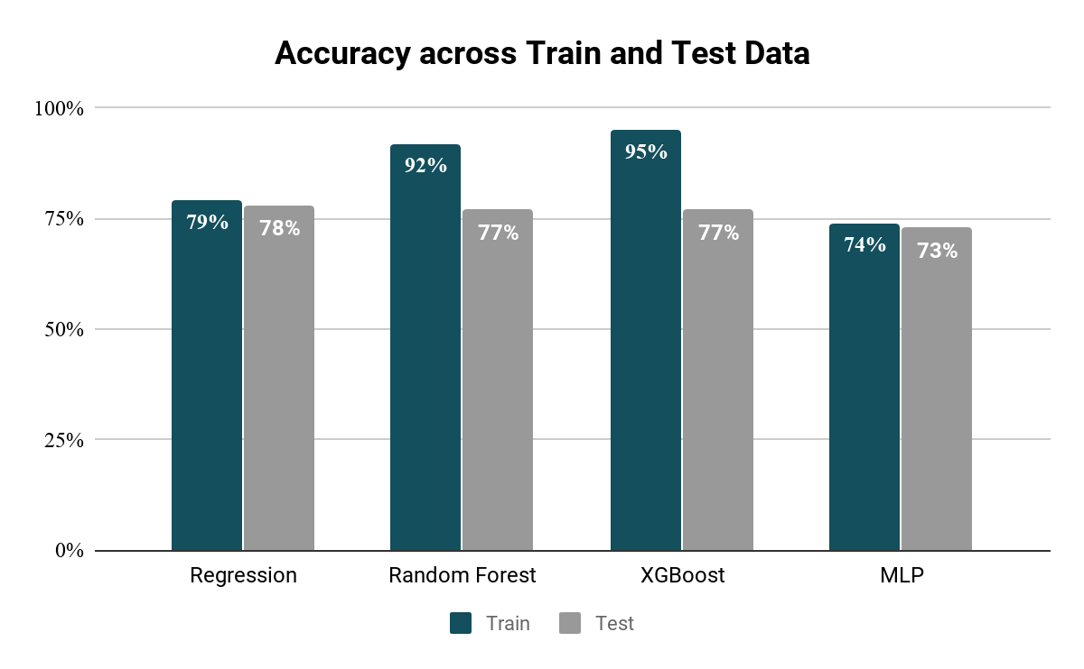
General Organization
Where to place new parking facilities?
Regression model is less prone to variance in predictions across train-test and is accurate

Slide 19
Conclusion
Individual level:
Our initial analyses and explorations suggest that there’s merit in exploring geohash travel path of vehicles that park at a GeoHash and recommended neighborhoods based on travel path have lower park time than that of actual neighborhood in which vehicles parked
Cluster analysis suggest that vehicles choose neighborhood to park primarily based on their distance, along with other considerations such as food and leisure attractions and availability of parking spots

Slide 20
Conclusion
General Organization:
Average parking time across different districts in Toronto is different.
Percentage vehicles searching for parking, Shop counts, restaurant counts, total travelled Geohashes of vehicles at Geohash parking spot, vehicle types that parked at GeoHash by proportion along with number of parking spots, predict average parking time of GeoHash with about 80% accuracy
While Regression approach seems robust it doesn’t explain much variance in average parking time across GeoHashes. (Missing features: Say Traffic by hour, Driver’s intended next task)

Slide 21
Limitations of Our Study
A major limitation of our study is all data used was aggregated measures across different GeoHashes in Toronto
GeoTab devices are largely installed on heavy and medium duty trucks and very few cars. The distribution of traffic by vehicle type is prone to biases from vehicles having GeoTab device installed
Not much temporal study such as weather influence and season of the year could be done due to lack of disaggregated measures at daily level

Slide 22
Limitations of Our Study
GeoHash are 7 character 150 * 150 regions, optimization problems might be addressed at larger levels for municipalities
It is not clear to us how it is determined if and when a vehicle starts to look for parking and our results might be exposed to biases from the way it is recorded
Regression studies suggested that the R-Squares are only about 22% which suggests there are potentially other missing features that could further explain the caused variance in average parking time across GeoHashes

Slide 23
Future Considerations
Devise a process to generate synthetic individual level data from aggregate measures and use finer grain data for analysis
Predict if a vehicle would park at a particular spot in a Geohash or neighborhood and how long would it take to park at that particular spot
Roll-Up GeoHash 7-code area to higher levels and repeat analysis
Obtain more available parking spots information data and device an imputation method for missing parking spots information across GeoHashes
Identify unseen geohash pairs similar to seen pairs from cluster analysis

Slide 24
Appendix: Supplementary Materials

Slide 25
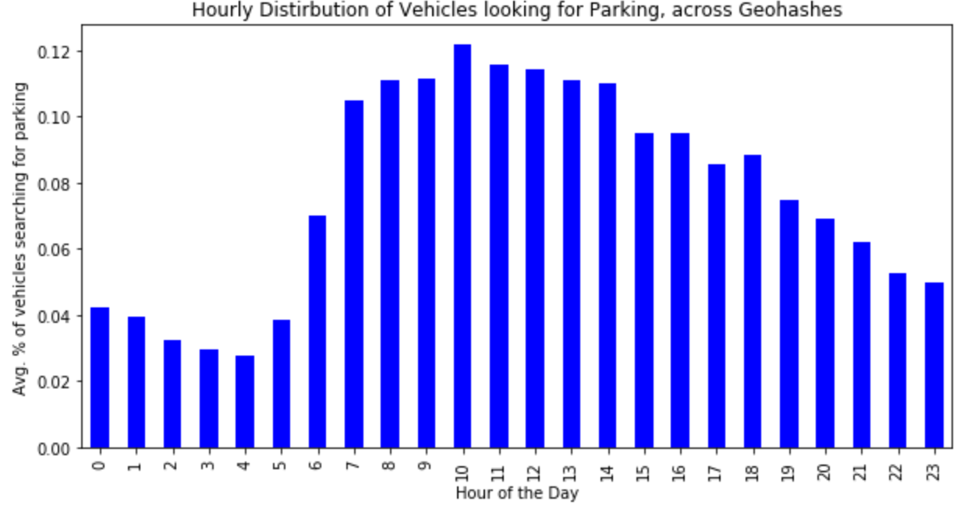
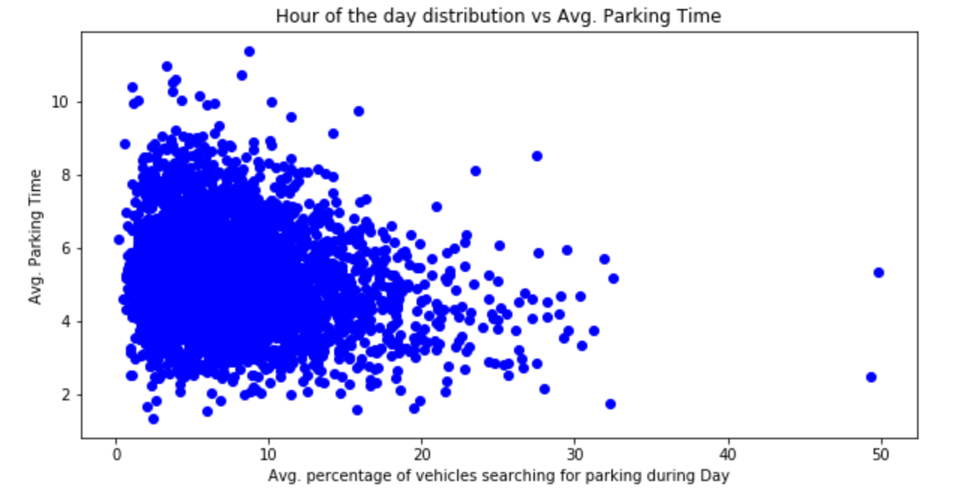
General Organization
What time of the day most geohashes experience high parking volume?

Slide 26
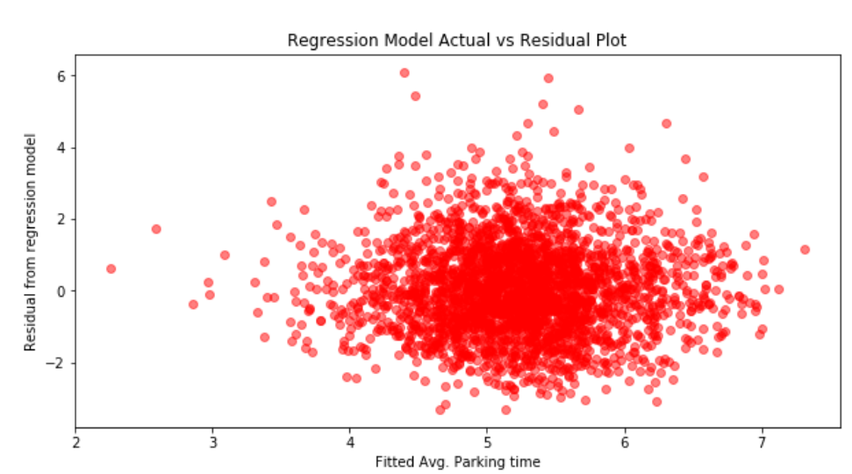
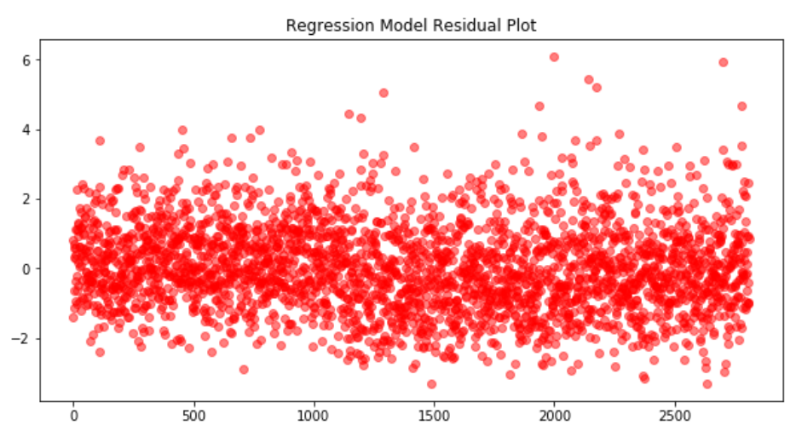
General Organization
Where to place new parking facilities?
Residuals from regression model don’t exhibit any relationship with fitted values and are scattered around zero.

Slide 27
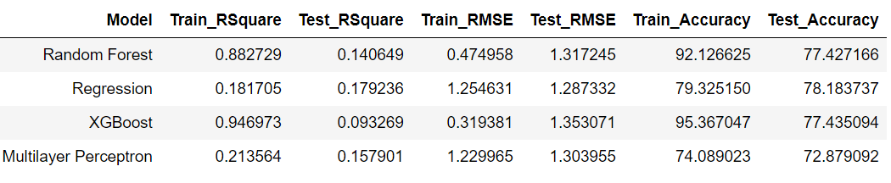
General Organization
Where to place new parking facilities?
Comparison of different model results

